Slide 1
Introduction to Basic Python Usage and Functions

Slide 2

Python Syntax
Indentation is crucial in Python.
Python uses statements and expressions to perform operations.
Example:
x = 5
if x > 2:
print('x is greater than 2')

Slide 3
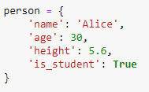
Variables and Data Types
Variables store data values.
Common data types: int, float, str, bool, list, dict.
person is a dict. Dictionary (dict) is a collection of key-value pairs, where each key is unique and maps to a value.
name is a str (String). A string is a sequence of characters and is used to represent text in Python
age is an int (Integer). Integers in Python are whole numbers, and they can be positive, negative, or zero.
height is a float (Floating Point Number). Floats in Python are numbers that contain a decimal point, and they are used to represent fractional numbers.
is_student is a bool (Boolean). Booleans in Python can only have one of two values: True or False. They are used to represent truth values and are commonly used in conditional statements

Slide 4
Arithmetic Operators
Arithmetic operators are used to perform mathematical operations between two or more values.
+ (Addition): Adds two numbers together.
Example: 5 + 3 results in 8.
- (Subtraction): Subtracts the right operand from the left operand.
Example: 10 - 4 results in 6.
* (Multiplication): Multiplies two numbers together.
Example: 6 * 7 results in 42.
/ (Division): Divides the left operand by the right operand, resulting in a float.
Example: 10 / 3 results in 3.3333....
// (Floor Division): Divides the left operand by the right operand and returns the largest integer less than or equal to the result.
Example: 10 // 3 results in 3.
% (Modulus): Returns the remainder when the left operand is divided by the right operand.
Example: 10 % 3 results in 1.
** (Exponentiation): Raises the left operand to the power of the right operand.
Example: 2 ** 3 results in 8 (2 raised to the power of 3).

Slide 5
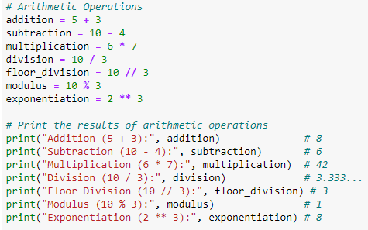
Example Arithmetic Operators

Slide 6
Comparison Operators
Comparison operators are used to compare two values and return a boolean (True or False).
== (Equal to): Returns True if the two operands are equal.
Example: 5 == 5 results in True.
!= (Not equal to): Returns True if the two operands are not equal.
Example: 5 != 3 results in True.
> (Greater than): Returns True if the left operand is greater than the right operand.
Example: 7 > 5 results in True.
< (Less than): Returns True if the left operand is less than the right operand.
Example: 3 < 8 results in True.
>= (Greater than or equal to): Returns True if the left operand is greater than or equal to the right operand.
Example: 5 >= 5 results in True.
<= (Less than or equal to): Returns True if the left operand is less than or equal to the right operand.
Example: 4 <= 6 results in True.

Slide 7
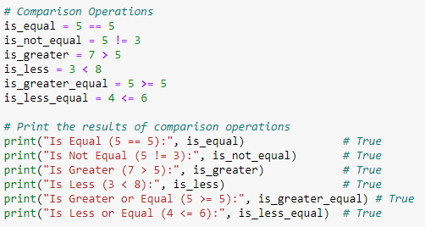
Comparison Operators

Slide 8
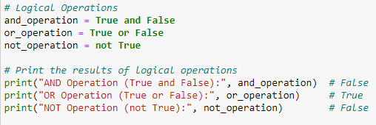
Logical Operators
Logical operators are used to combine conditional statements.
and: Returns True if both statements are True.
Example: True and False results in False.
or: Returns True if at least one of the statements is True.
Example: True or False results in True.
not: Reverses the boolean value.
Example: not True results in False.

Slide 9
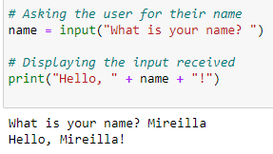
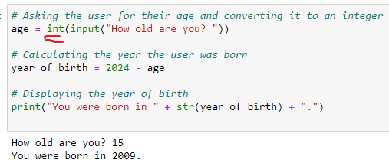
Input and Output
Even if the user types a number, the input is still treated as a string. To perform arithmetic operations, you must convert it to an integer int() or a float.
For interacting with users and displaying information.
Use input() to get user input.
Use print() to display output.
The input("What is your name? ") prompts the user with the text "What is your name? ". The user's input is stored as a string in the variable name.
The print() function is then used to display a greeting message that includes the user's name.
The result is converted back to a string using str() before being concatenated and displayed with print().

Slide 10
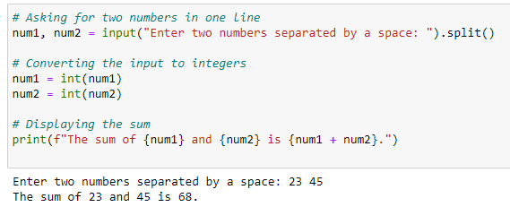
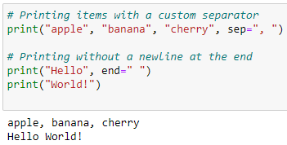
Input and Output
input().split() allows the user to enter multiple values separated by a space. It splits the input string into a list of substrings.
These values are then converted to integers and summed.
sep: This parameter changes the separator between items in a single print() call. By default, it is a space.
end: This parameter changes what is printed at the end of the print() call. By default, it is a newline, but you can change it to a space or anything else.

Slide 11
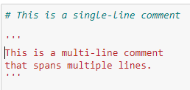
Comments and Documentation
Single-line comments start with #.
Multi-line comments use ''' or """.

Slide 12
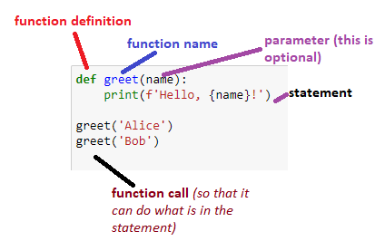
Defining and Calling Functions
def: This keyword is used to start the function definition.
function_name: The name you give to your function. It should be descriptive of what the function does.
parameters: Inputs to the function (optional). You can have zero, one, or more parameters.
statements: The block of code that runs when the function is called. This is indented to signify that it's part of the function.
A function in Python is a block of reusable code that performs a specific task.
Functions help in organising code, making it more modular, and reducing repetition.
They can take inputs, process them, and return a result

Slide 13
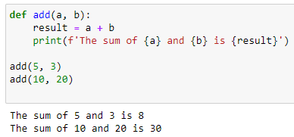
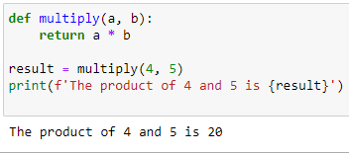
Functions with Multiple Parameters /Return values
Function Definition:
def add(a, b): defines a function that takes two parameters, a and b.
Inside the function, the result is calculated by adding a and b.
The function then prints the result using print().
Function Calls:
add(5, 3) calls the function with 5 and 3 as arguments, resulting in the output The sum of 5 and 3 is 8.
add(10, 20) calls the function with 10 and 20 as arguments, resulting in the output The sum of 10 and 20 is 30.
Function Definition:
def multiply(a, b): defines a function that takes two parameters, a and b.
The function returns the product of a and b using the return statement.
Function Call and Return Value:
multiply(4, 5) calls the function with 4 and 5 as arguments, and the function returns 20.
The returned value (20) is stored in the variable result.
The print() function then outputs The product of 4 and 5 is 20.

Slide 14
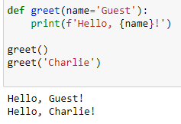
Functions with Default Parameters
You can define functions with default parameter values. If no argument is provided for that parameter when the function is called, the default value is used.
Function Definition:
def greet(name='Guest'): defines a function with a default parameter name set to 'Guest’.
If the function is called without providing an argument, name will default to 'Guest’.
Function Calls:
greet() calls the function without any arguments, so it uses the default value and prints Hello, Guest!.
greet('Charlie') calls the function with the argument 'Charlie', so it prints Hello, Charlie!.

Slide 15
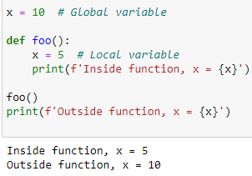
Scope of Variables
Variables defined inside a function (local variables) are only accessible within that function.
Variables defined outside any function (global variables) are accessible throughout the code.
Global Variable:
x = 10 defines a global variable x.
Local Variable:
Inside the function foo(), x = 5 defines a local variable x that shadows the global x within the function scope.
Inside the function, x is 5, but outside the function, x remains 10.
The term "shadowing" in programming refers to the situation where a local variable in a function has the same name as a global variable.
When this happens, the local variable "shadows" or hides the global variable within the scope of the function.
This means that inside the function, any reference to that variable name will refer to the local variable, not the global one.

